Slide 1
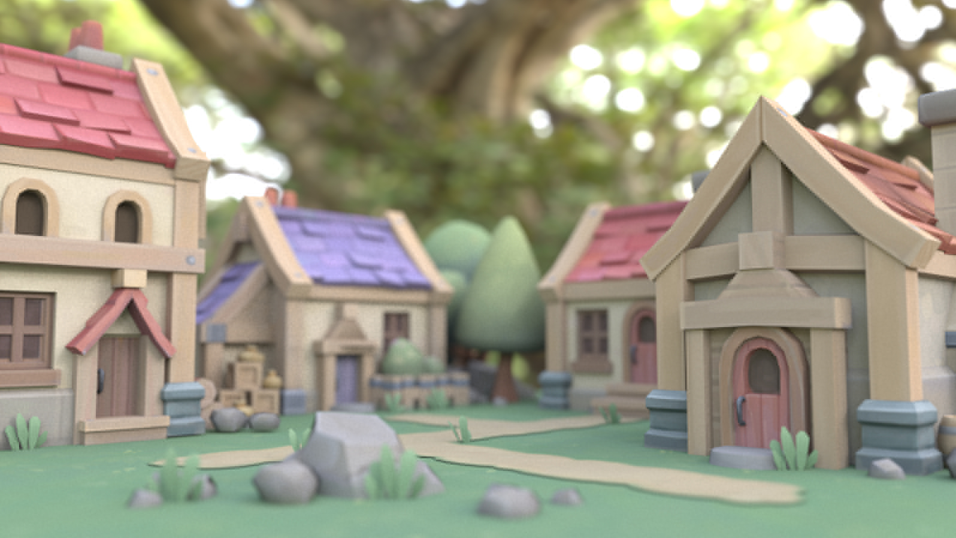
Efficient octree traversal
for real-time path tracing systems

Slide 2
Octrees are one of my favorite spatial data structures because of their simplicity and efficiency — they’re easy to understand and visualize, and can significantly improve the performance of a task.
The Final Stage path tracer uses octrees to reduce rendering time by about 100x, so I thought it might be interesting to explore how this was achieved.

Slide 3
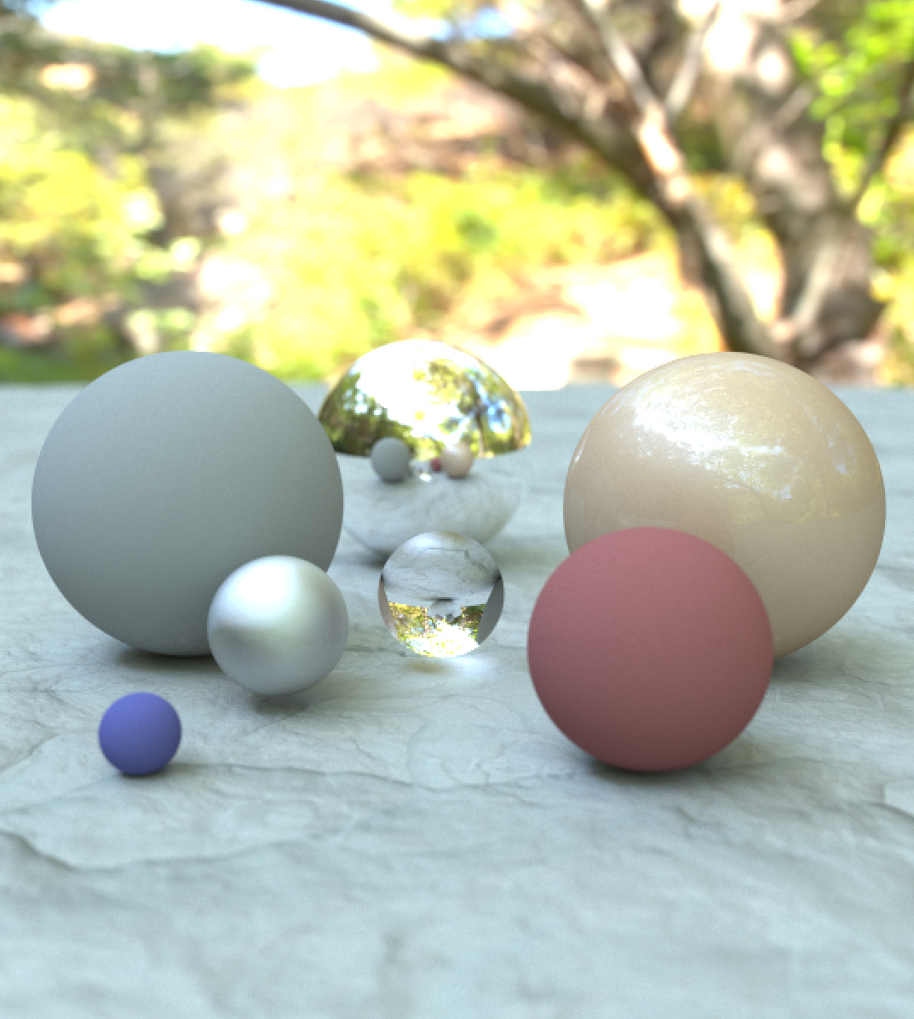
THE PROBLEM
Photorealistic rendering algorithms often require us to determine where a photon ray first collides with objects in our scene
(aka ray-scene collision detection).
Modern renderers perform this kind of collision detection hundreds of billions of times to generate a single frame, so performance is incredibly important.

Slide 4
THE PROBLEM
Specifically, given a collection of objects that comprise our scene, and a photon travelling in a straight line (i.e. a photon ray), determine the first object, if any, that is struck by the photon.
Result: the first object struck by the photon ray is a small red sphere.
PHOTON RAY
SCENE
Notes:
Example scene with lots of high resolution objects in it.

Slide 5
THE PROBLEM
Things we definitely don’t want to do:
✘ Test our photon ray against every object in the scene
✘ Test our photon ray against every polygon of every object
✘ Rely solely on non-spatial data structures to represent our scene
Doing any of these will severely impact performance!

Slide 6
THE SOLUTION
Our solution needs to scale to support scenes with an arbitrary number of objects, and an arbitrary number of polygons. Ideally, memory should be the limiting factor, not processing power.
So how do we optimize our ray-scene collision detection?

Slide 7
THE SOLUTION
Bounding volume hierarchies
We divide the scene into a hierarchy of spatial regions that allow us to disregard large groups of objects when we know that the photon will not pass through their vicinity (aka bounding volume).
There are many different types of BVHs, including octrees, bsp trees, quadtrees, kd trees, and many more. We’re going to focus on octrees.

Slide 8
THE SOLUTION
Bounding volume hierarchies give us logarithmic computational cost as scene complexity increases. Approaches that consider every object will be linear at best!
testing every object
Computational cost
using a bvh
Scene complexity

Slide 9
OCTREE STRUCTURE
Data structure
Each node references up to 8 children
Spatial structure
Each node represents an axis aligned sub-volume of the parent node
0
1
2
3
4
5
6
7
8
Tree depth restricted to some maximum depth (e.g. d=32)

Slide 10
OCTREE STRUCTURE
Data structure
Each node references up to 8 children
Spatial structure
Each node represents an axis aligned sub-volume of the parent node
0
1
2
3
4
5
6
7
8
Tree depth restricted to some maximum depth (e.g. d=32)

Slide 11
OCTREE STRUCTURE
Data structure
Each node references up to 8 children
Spatial structure
Each node represents an axis aligned sub-volume of the parent node
0
1
2
3
4
5
6
7
8
Tree depth restricted to some maximum depth (e.g. d=32)

Slide 12
OCTREE STRUCTURE
Data structure
Each node references up to 8 children
Spatial structure
Each node represents an axis aligned sub-volume of the parent node
0
1
2
3
4
5
6
7
8
Tree depth restricted to some maximum depth (e.g. d=32)

Slide 13
OCTREE STRUCTURE
Data structure
Each node references up to 8 children
Spatial structure
Each node represents an axis aligned sub-volume of the parent node
0
1
2
3
4
5
6
7
8
Tree depth restricted to some maximum depth (e.g. d=32)

Slide 14
OCTREE STRUCTURE
Data structure
Each node references up to 8 children
Spatial structure
Each node represents an axis aligned sub-volume of the parent node
0
1
2
3
4
5
6
7
8
Tree depth restricted to some maximum depth (e.g. d=32)

Slide 15
OCTREE STRUCTURE
Data structure
Each node references up to 8 children
Spatial structure
Each node represents an axis aligned sub-volume of the parent node
0
1
2
3
4
5
6
7
8
Tree depth restricted to some maximum depth (e.g. d=32)

Slide 16
OCTREE STRUCTURE
Data structure
Each node references up to 8 children
Spatial structure
Each node represents an axis aligned sub-volume of the parent node
0
1
2
3
4
5
6
7
8
Tree depth restricted to some maximum depth (e.g. d=32)

Slide 17
OCTREE STRUCTURE
Data structure
Each node references up to 8 children
Spatial structure
Each node represents an axis aligned sub-volume of the parent node
0
1
2
3
4
5
6
7
8
Tree depth restricted to some maximum depth (e.g. d=32)

Slide 18
OCTREE STRUCTURE
Data structure
Each node references up to 8 children
Spatial structure
Each node represents an axis aligned sub-volume of the parent node
0
1
2
3
4
5
6
7
8
Tree depth restricted to some maximum depth (e.g. d=32)

Slide 19
OCTREE STRUCTURE
Node description
Each node boundary can be described by a center point and a span.
For convenience we also define three axis aligned dividing planes (YZ, XZ, XY).
We’ll use these to quickly determine intersections between our ray and the nearest child volume.

Slide 20
INTERFACE
Thus, our goal is to create an Octree class that supports the following operations:
Construction: Octree::Initialize(scene)
Initializes our octree object with scene data. Performed once during setup, or whenever the scene changes.
Traversal: Octree::Trace(ray, collision)
Efficiently checks for collisions between the ray and our scene. Stores information within collision parameter about the closest collision found, if any. Performed many times per frame.

Slide 21
OCTREE CONSTRUCTION
void Octree::Initialize(scene) {
allocate a root_node
for each polygon in the scene:
add the polygon to the root_node
if any of polygon’s vertices are outside of root bounds:
expand root bounds to cover it
call root_node.Subdivide(0)
}
void OctreeNode::Subdivide(depth) {
if depth >= maximum allowable depth or
bounding volume is too small or
total polycount in node bounds < minimum polycount
return
for each child node index:
create the node and set its bounding volume equal to
the respective sub-volume of the current node.
for each polygon in the current node:
add it to any children that it intersects, or optionally
split polygons along node boundaries and add pieces
to respective child nodes
clear all polygons out of the current node
for each child node:
call Subdivide on the child node
}
Initialization:
Constructs the root node and then kicks off recursive subdivision to initialize children.
Subdivision:
Constructs the spatial hierarchy such that:
Each node has exactly zero or eight children
Parent bounds is the union of its child node bounds
Polygons are only referenced by leaf nodes
Halt subdivision when node volume becomes too small, node manages a small number of polygons, or we reach maximum tree depth.
Optimizations:
Avoid empty child nodes
Split polygons along node boundaries
Multi-threaded construction
Be careful with memory management of polygons

Slide 22
TRAVERSAL
Attempt 1: naïve top/down traversal
Recursively test nodes, beginning with the root. If a collision is detected against the current node bounds, recursively test every child. Maintain a running knowledge of the closest collision found.

Slide 23
TOP/DOWN TRAVERSAL
void Octree::Trace(ray, collision) {
root_node.Trace(ray, collision)
}
void OctreeNode::Trace(ray, collision) {
if ray does not intersect node bounds:
return
if a collision has already been detected and it’s closer
than the ray entry point into this node:
return
if node is a leaf:
for each polygon in node:
if ray intersects polygon:
if intersection is closer to ray origin than collision:
update collision with current intersection
else:
for each child_node:
child_node.Trace(ray, collision)
}
Conditions:
A node is considered a leaf if it contains any polygons. Non-leaf nodes will not reference any polygons.
Process:
Start at the root and check it’s children only if the ray intersects the root bounds. Recursively repeat this process for children, and keep track of the best collision (closest to the ray origin) encountered.
Issues:
We traverse child nodes in a fixed order
We check every child, even if the nearest collision has already been found

Slide 24
TRAVERSAL
Attempt 2: top/down with distance sorted siblings
Recursively test nodes, beginning with the root. If collision detected against current node bounds, recursively test each child using front-to-back order from the ray origin.
Halt the entire process once a collision is found.

Slide 25
SORTED SIBLING TRAVERSAL
void Octree::Trace(ray, collision) {
root_node.Trace(ray, collision)
}
void OctreeNode::Trace(ray, collision) {
if ray does not intersect node bounds:
return
if a collision has already been detected and it’s closer
than the ray entry point into this node:
return
if node is a leaf:
for each polygon in node:
if ray intersects polygon:
if intersection is closer to ray origin than collision:
update collision with current intersection
else:
for i = 0, i < 4, ++i:
determine nearest untested node to the ray origin
call node.Trace(ray, collision)
if collision detected:
break
}
Process:
Start at the root and check it’s children only if the ray intersects the root bounds.
When checking non-leaf children, begin with the child closest to the ray origin, and then test progressively farther child nodes. If a collision is detected within a leaf node, halt the entire process.
We check at most 4 children of any given node. If a collision is not detected in the nearest 4 nodes, there won’t be a collision in the remaining 4 either.
But how do we know the order to process child nodes?

Slide 26
SORTED SIBLING TRAVERSAL
Two key steps for determining the proper traversal order of child nodes:
Finding the closest child node to a given point (often the ray origin)
Finding the next nearest untested child node
Cases to consider:
Does the ray originate from outside of the parent node?
Is the ray pointing away from all child nodes?
Does the ray graze a node boundary?
If these are both true, the ray will not intersect any child

Slide 27
SORTED SIBLING TRAVERSAL
int OctreeNode::ClosestChild(point) {
oriented_point = point - node_center
x_test = oriented_point.x >= 0.0
y_test = oriented_point.y >= 0.0
z_test = oriented_point.z >= 0.0
return x_test | (y_test << 1) | (z_test >= 0.0 << 2)
}
Finding the nearest child relative to a point:
Recall that we defined our nodes as the combination of a point, a span, and three planes. If we orient our point (which is often the ray origin) relative to the node center, then we can quickly determine which child node is nearest by comparing the oriented point with the basis x, y, and z planes.
In other words, for the oriented point [x’, y’, z’]:
If x >= 0, then it is closest to a positive x child node
If y >= 0, then it is closest to a positive y child node
If z >= 0, then it is closest to a positive z child node
The combination of these boolean results uniquely identifies which node must be closest to the point.

Slide 28
SORTED SIBLING TRAVERSAL
int OctreeNode::ClosestChild(point) {
oriented_point = point - node_center
x_test = oriented_point.x >= 0.0
y_test = oriented_point.y >= 0.0
z_test = oriented_point.z >= 0.0
return x_test | (y_test << 1) | (z_test >= 0.0 << 2)
}
Finding the nearest child relative to a point:
Recall that we defined our nodes as the combination of a point, a span, and three planes. If we orient our point (which is often the ray origin) relative to the node center, then we can quickly determine which child node is nearest by comparing the oriented point with the basis x, y, and z planes.
In other words, for the oriented point [x’, y’, z’]:
If x >= 0, then it is closest to a positive x child node
If y >= 0, then it is closest to a positive y child node
If z >= 0, then it is closest to a positive z child node
The combination of these boolean results uniquely identifies which node must be closest to the point.
Packaging the response
For convenience, we combine the results into an index that matches the order that we allocated child nodes in the tree. The following table describes this mapping:
Binary value
Quadrant
000
001
010
011
…
111
-X, -Y, -Z
+X, -Y, -Z
-X, +Y, -Z
+X, +Y, -Z
…
+X, +Y, +Z

Slide 29
SORTED SIBLING TRAVERSAL
closest_node_index = ClosestChild(ray.origin)
plane_hit[0] = result of ray intersection test against YZ plane
plane_hit[1] = result of ray intersection test against XZ plane
plane_hit[2] = result of ray intersection test against XY plane
for i = 0, i < 4, ++i:
if child_node at closest_node_index is valid:
call child_node.Trace(ray, collision)
if collision detected:
break;
plane_index = index of closest valid plane_hit collision
if there are no valid plane collisions or
closest plane collision point is outside parent bounds:
break;
closest_node_index ^= 0x1 << plane_index
invalidate plane_hit[plane_index]
Finding the next nearest sibling to check
We check for collisions between the ray and each of the parent node’s three axis planes. The nearest plane that is struck will indicate the entry point of the ray into the next nearest sibling.
If no plane is hit, then the ray is headed out of the node and will not hit any other children of the current parent.
.
Example:
A ray exiting the (-X,+Y,-Z) quadrant with a collision against the YZ plane will enter the (+X,+Y,-Z) quadrant as the next nearest sibling node in our traversal.

Slide 30
SORTED SIBLING TRAVERSAL
closest_node_index = ClosestChild(ray.origin)
plane_hit[0] = result of ray intersection test against YZ plane
plane_hit[1] = result of ray intersection test against XZ plane
plane_hit[2] = result of ray intersection test against XY plane
for i = 0, i < 4, ++i:
if child_node at closest_node_index is valid:
call child_node.Trace(ray, collision)
if collision detected:
break;
plane_index = index of closest valid plane_hit collision
if there are no valid plane collisions or
closest plane collision point is outside parent bounds:
break;
closest_node_index ^= 0x1 << plane_index
invalidate plane_hit[plane_index]
Finding the next nearest sibling to check
We check for collisions between the ray and each of the parent node’s three axis planes. The nearest plane that is struck will indicate the entry point of the ray into the next nearest sibling.
If no plane is hit, then the ray is headed out of the node and will not hit any other children of the current parent.
.
Example:
A ray exiting the (-X,+Y,-Z) quadrant with a collision against the YZ plane will enter the (+X,+Y,-Z) quadrant as the next nearest sibling node in our traversal.
Configuring the next nearest child node
If we get here, it means the child_node did not have a collision. We update closest_node_index to indicate the next nearest sibling node and disqualify the current child from future consideration.
.

Slide 31
SORTED SIBLING TRAVERSAL
void OctreeNode::Trace(ray, collision) {
if ray does not intersect node bounds:
return
if a collision has already been detected and it’s closer
than the ray entry point into this node:
return
if node is a leaf:
for each polygon in node:
if ray intersects polygon:
if intersection is closer to ray origin than collision:
update collision with current intersection
else:
closest_node_index = ClosestChild(ray.origin)
plane_hit[0] = ray intersection test against YZ plane
plane_hit[1] = ray intersection test against XZ plane
plane_hit[2] = ray intersection test against XY plane
for i = 0, i < 4, ++i:
if child_node at closest_node_index is valid:
call child_node.Trace(ray, collision)
if collision detected:
break;
plane_index = index of closest valid plane_hit collision
if there are no valid plane collisions or
closest plane collision point is outside parent bounds:
break;
closest_node_index ^= 0x1 << plane_index
invalidate plane_hit[plane_index]
}
Putting it all together:
Skip nodes that do not intersect the ray
If the node is a leaf, test its polygons
If the node is not a leaf recursively test up to 4 child nodes that are nearest to the ray origin
Halt the entire process the moment a collision is detected, or the ray exits the parent bounds.
Optimizations:
Perform ray-plane intersection tests only if a collision isn’t found within the nearest child node.

Slide 32
RESULTS
Final Stage 2.0 uses nearest neighbor octree traversal. This enabled a 10x improvement over naïve traversal, and a 100x improvement over an initial non-BVH solution.
No BVH
Simple traversal
Sorted sibling traversal
Render time
1,000 ms
100 ms
10 ms

Slide 33
CONCLUSION
Bounding volume hierarchies can significantly improve the performance of spatial search operations. Commonly used in rendering, but also applicable elsewhere.
Lots of libraries from Intel, Nvidia, AMD that do the heavy lifting for you.

Slide 34
CONCLUSION
Thanks for listening (or reading)!
Don’t forget to check out the source for Final Stage 2.0, which demonstrates most of the concepts discussed in this talk.

