Slide 1
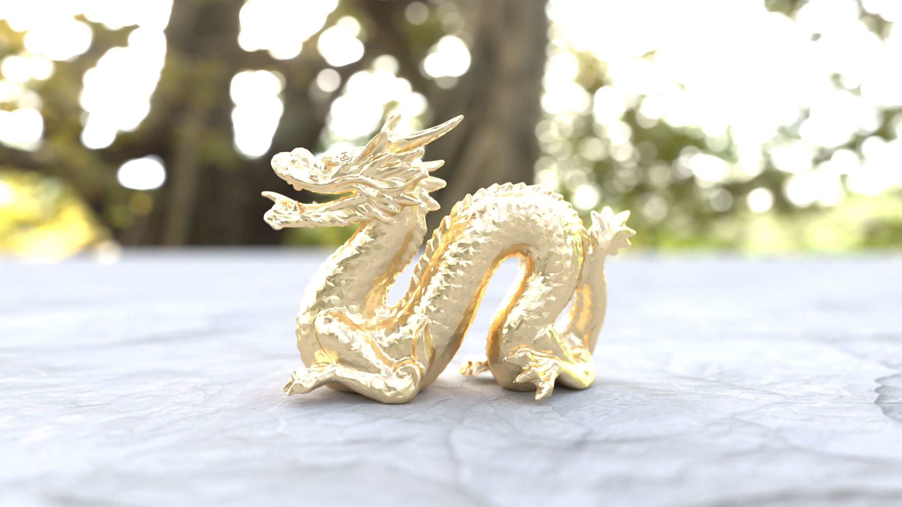
Simple Geometric Image Denoising
for Real-time Path Tracers

Slide 2
While developing Final Stage I created a basic image denoiser that was surprisingly effective given its simplicity.
Now, there’s a lot of research in this area, and several robust solutions are available that leverage artificial intelligence and GPU acceleration to produce stunning results.
So why didn’t I use them, and instead decide to reinvent a wheel?

Slide 3
Final Stage is a fun side project. Reinventing the wheel is part of the fun! This lets you see how far you can get by yourself and learn a bit about wheel construction.
I wanted a simple approach that I could drop into Final Stage, without requiring special hardware or closed/third-party software.

Slide 4
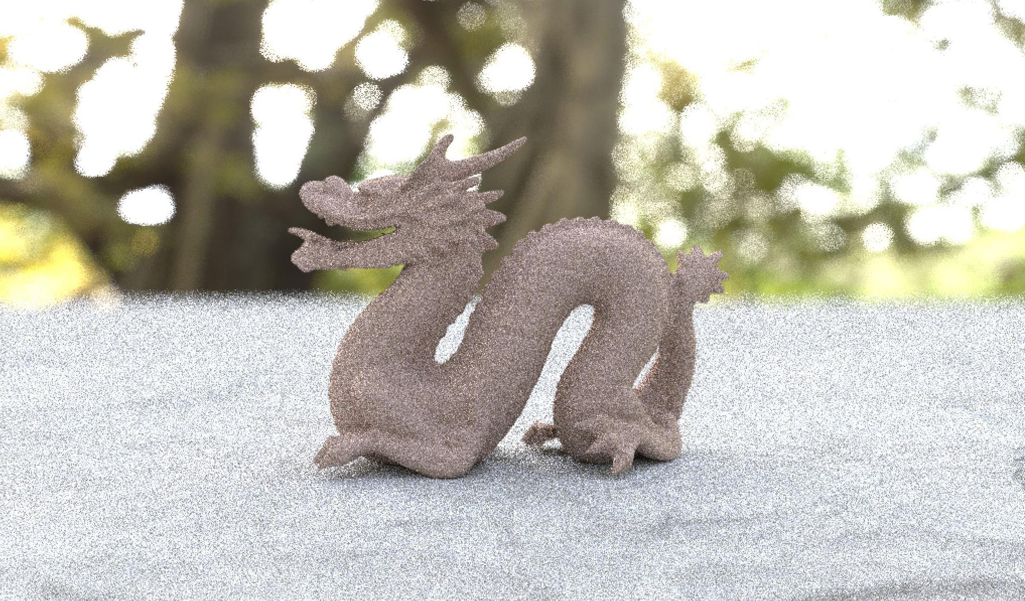
THE PROBLEM
Photorealistic rendering algorithms often rely on random sampling to render an image of a scene. This approach presents results quickly, but produces highly noticeable image noise.
Over time, this noise will become less visible as the pixel samples converge on their final values, but this can take a very long time.
Image denoising is a process integrated into the path tracer that helps us quickly improve our image quality by filtering and smoothing out grainy artifacts.
Final Stage render using 50 samples per pixel (spp). Due to the low sample count, this image suffers from significant grainy noise.

Slide 5
Image denoising is actually a broad collection of very useful processes that are used not only in path tracers, but also in video compression, computer vision, video capture pipelines, and much more.
Anywhere that noise may find its way into an image, denoising filters are there to help clean things up. There are many different kinds of noise, and fortunately there are equally many ways of correcting it.

Slide 6
Before we dive into the process, let’s take a quick look at some results to provide context

Slide 7
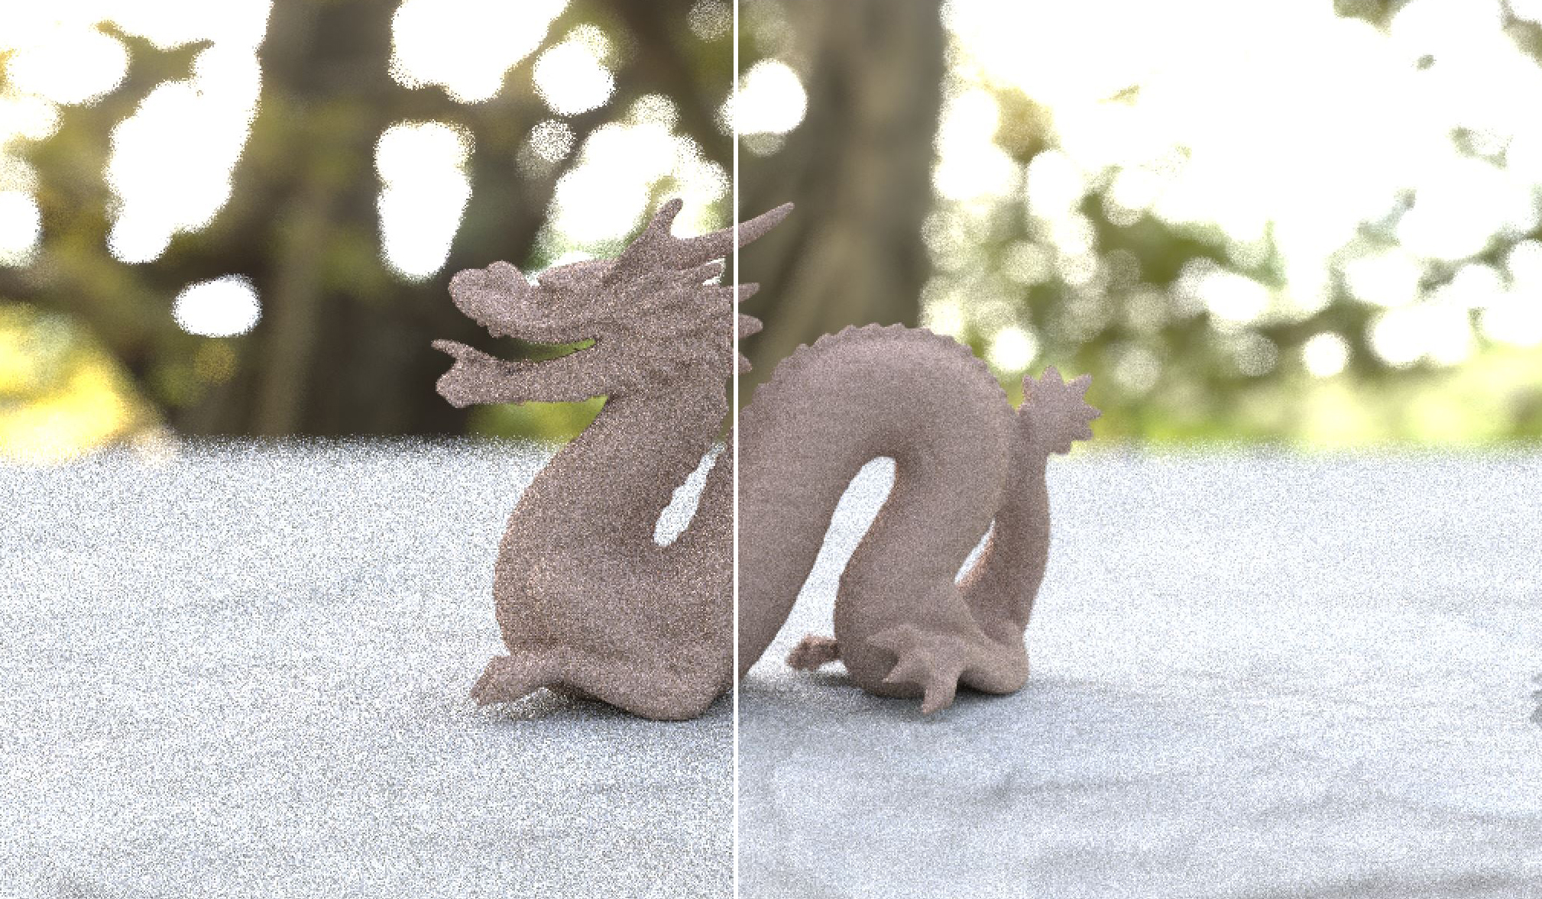
no denoise filter
geometric denoise filter

Slide 8
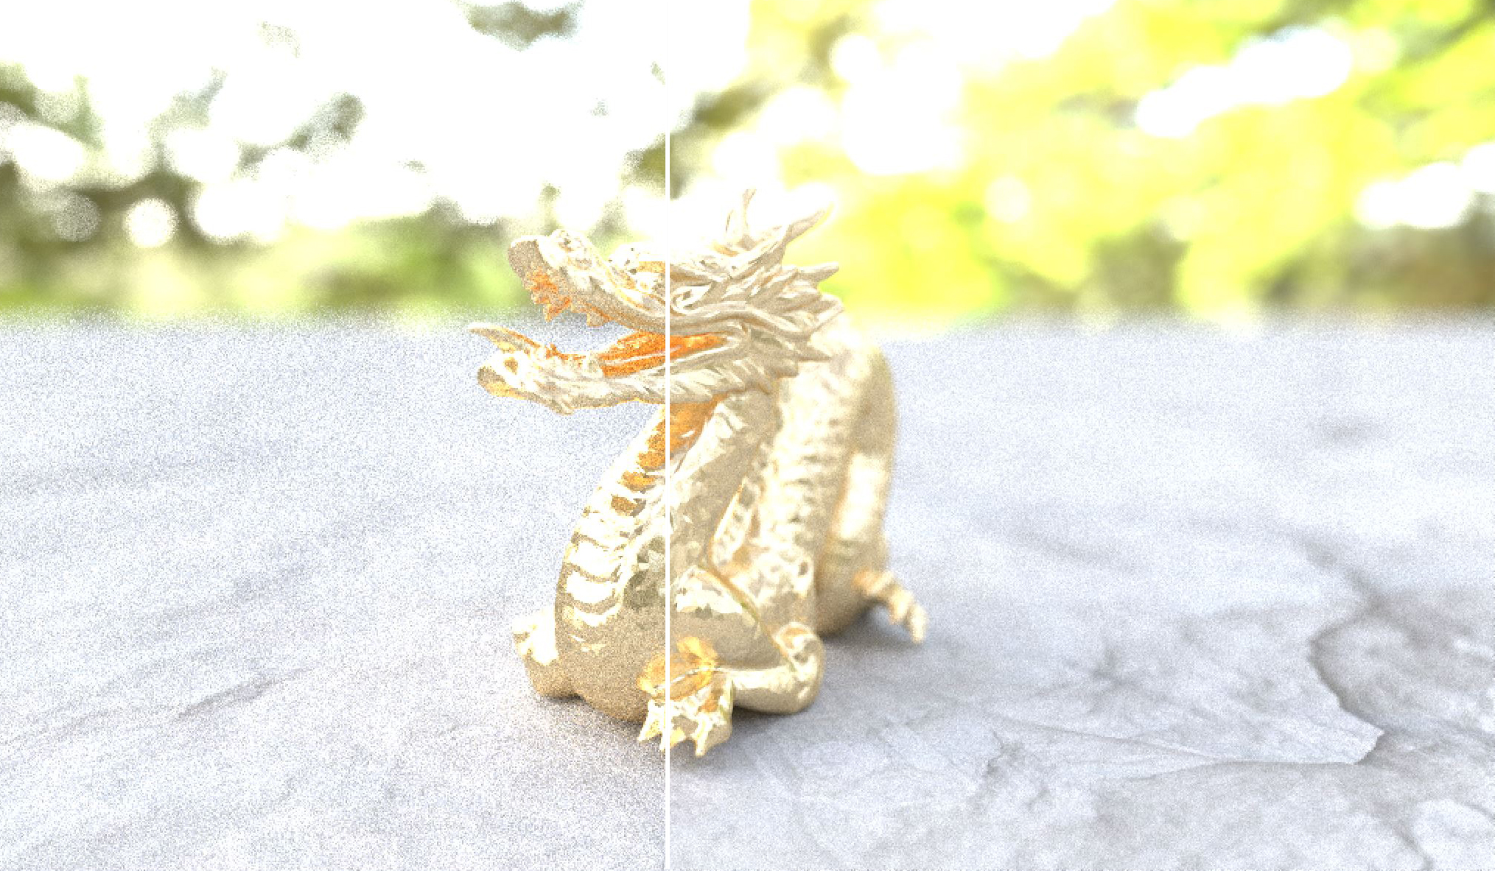
no denoise filter
geometric denoise filter

Slide 9
Denoising filter introduces blur and gradient artifacts, but removes graininess. From a visual perception standpoint, the filter appears to roughly improve image quality equivalent to that of a 300% increase in sample count.
Image improvement more readily noticeable on smooth diffuse surfaces, less so on reflective or complex surfaces.

Slide 10
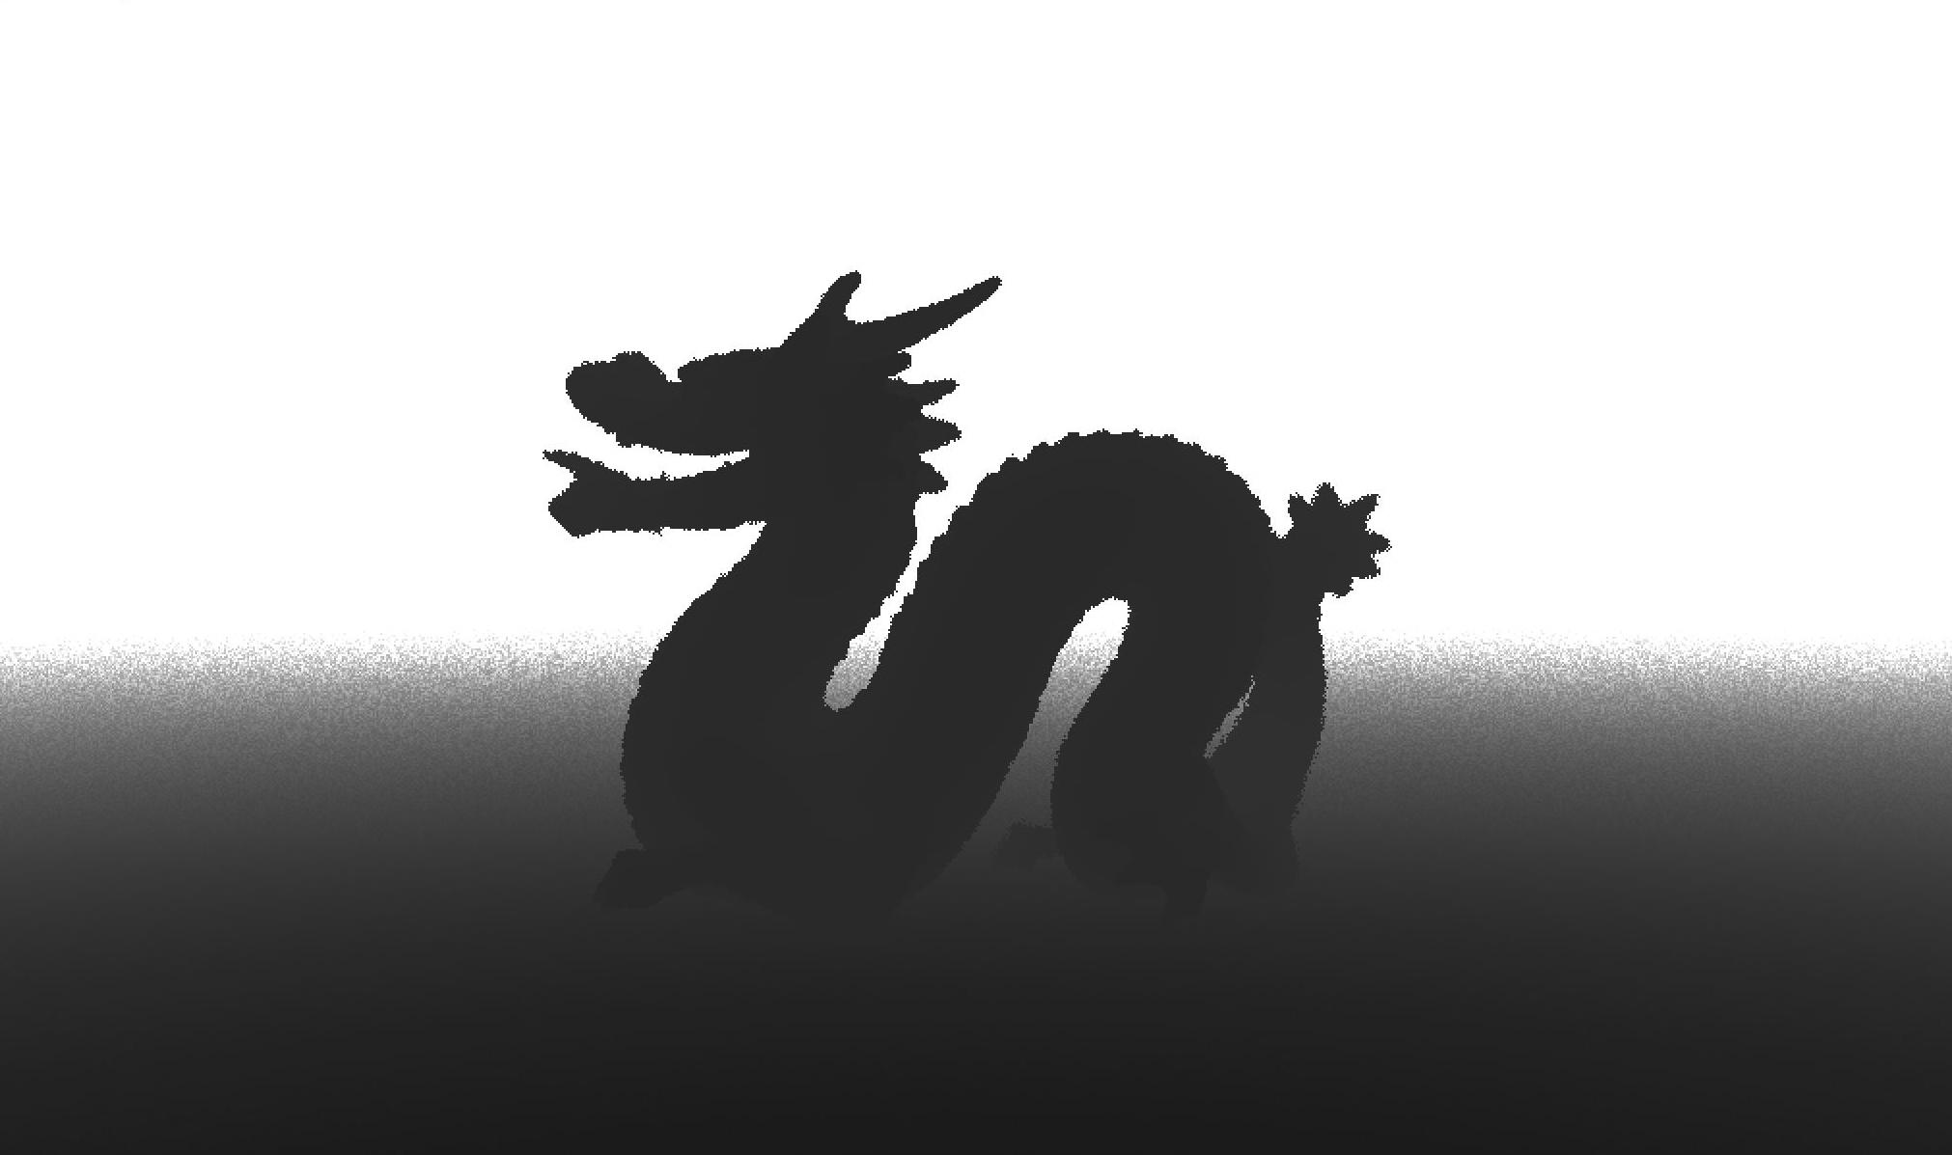
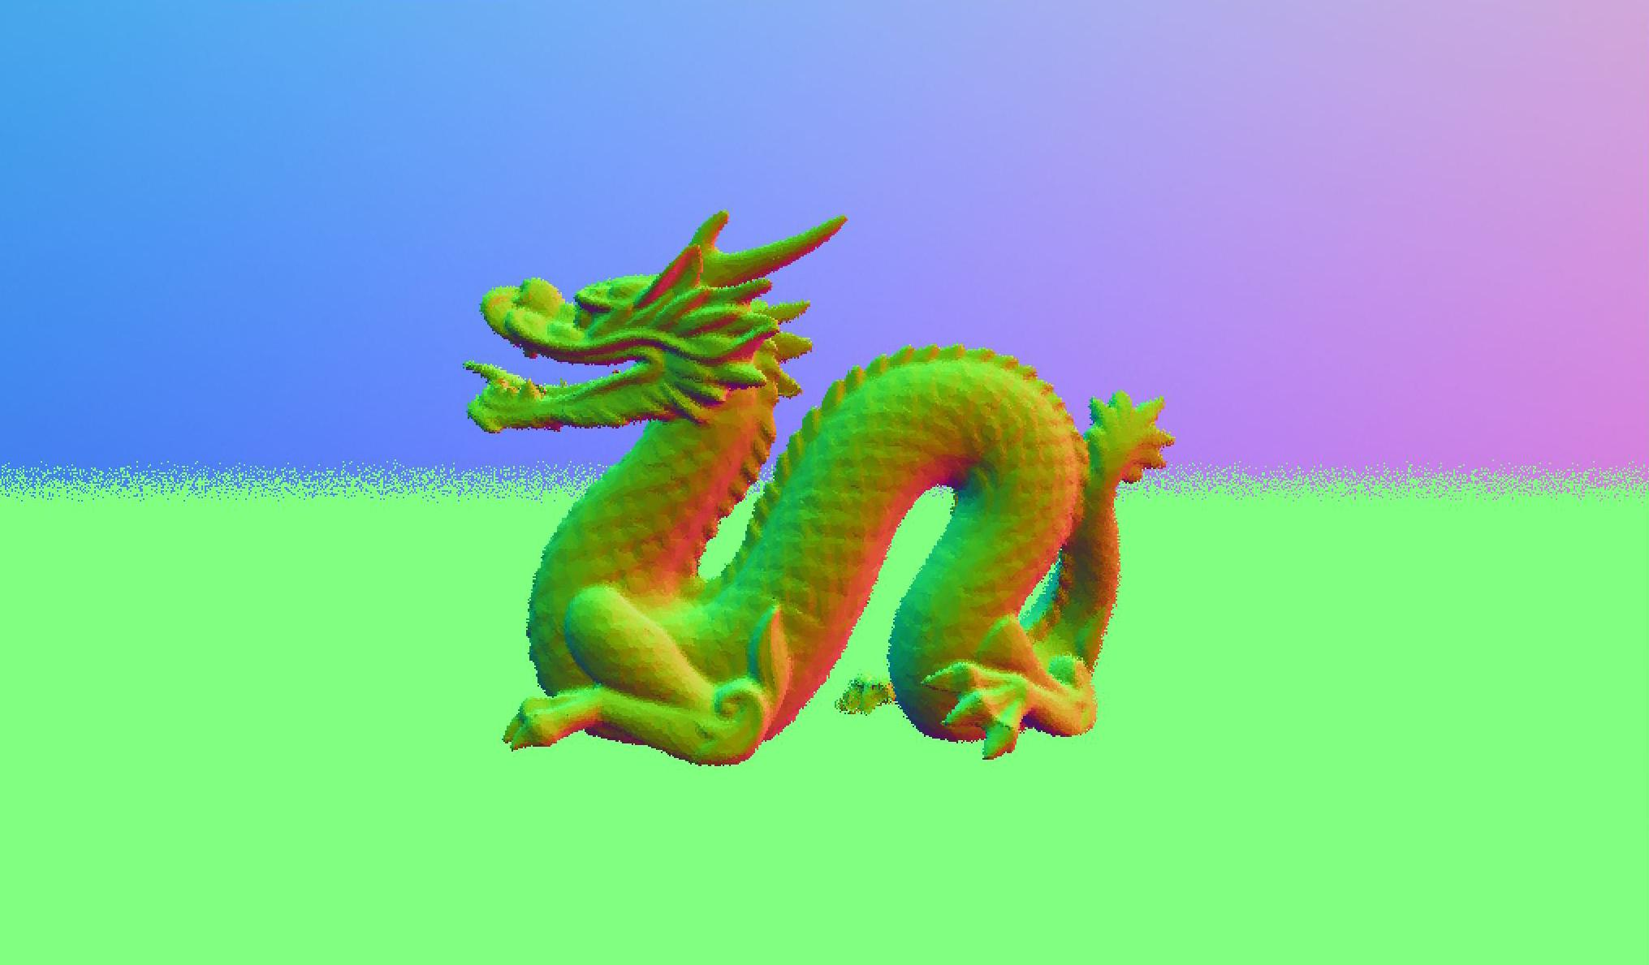
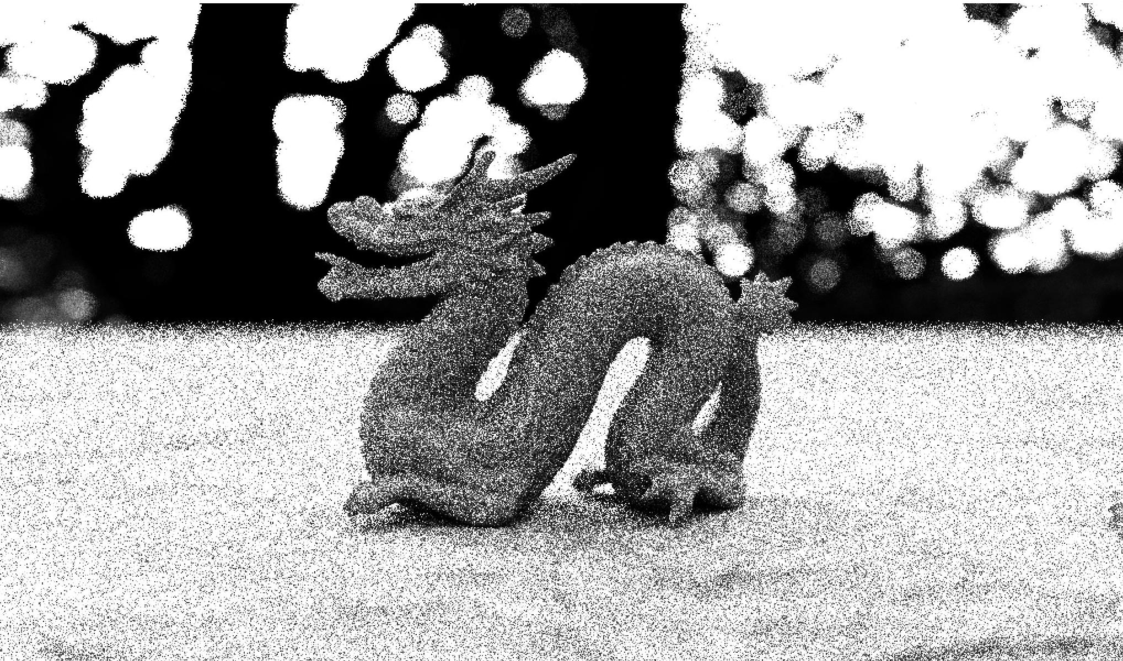
THE SOLUTION
1
Trace the scene as normal, but keep track of the following information for each pixel:
Distance to the nearest object (i.e. depth map)
Normal vector at the nearest object (i.e. normal map)
Material id of the nearest object (just a random number generated for each material type)
Mean color value of all the samples collected thus far
Variance observed thus far
depth map
normal map
variance map (scaled)

Slide 11
THE SOLUTION
2
After each frame completes, apply a smoothing filter to the image:
for each pixel p in the image:
color_total = color at pixel p
kernel_size = pixel_variance * 2.0
for each neighboring pixel n within a kernel_size radius:
if material id at n != material id at p:
skip pixel n
if depth at n is > depth_threshold away from depth at p:
skip pixel n
if dot(normal at n, normal at p) is > normal_threshold:
skip pixel n
weight = (1.0 - distance of n to p) / kernel_size
weight_total += weight
color_total += (color at n) * weight
if color_total > 0:
color_total /= weight_total

Slide 12
THE SOLUTION
2
After each frame completes, apply a smoothing filter to the image:
for each pixel p in the image:
color_total = color at pixel p
kernel_size = pixel_variance * 2.0
for each neighboring pixel n within a kernel_size radius:
if material id at n != material id at p:
skip pixel n
if depth at n is > depth_threshold away from depth at p:
skip pixel n
if dot(normal at n, normal at p) is > normal_threshold:
skip pixel n
weight = (1.0 - distance of n to p) / kernel_size
weight_total += weight
color_total += (color at n) * weight
if color_total > 0:
color_total /= weight_total
Arbitrarily multiplying pixel variance to get kernel size.
Determined by trial and error, 2.0 seems to work well.

Slide 13
THE SOLUTION
2
After each frame completes, apply a smoothing filter to the image:
for each pixel p in the image:
color_total = color at pixel p
kernel_size = pixel_variance * 2.0
for each neighboring pixel n within a kernel_size radius:
if material id at n != material id at p:
skip pixel n
if depth at n is > depth_threshold away from depth at p:
skip pixel n
if dot(normal at n, normal at p) is > normal_threshold:
skip pixel n
weight = (1.0 - distance of n to p) / kernel_size
weight_total += weight
color_total += (color at n) * weight
if color_total > 0:
color_total /= weight_total
Our kernel size scales with our uncertainty about the true pixel value.
Less certainty → accumulate more pixels.

Slide 14
THE SOLUTION
2
After each frame completes, apply a smoothing filter to the image:
for each pixel p in the image:
color_total = color at pixel p
kernel_size = pixel_variance * 2.0
for each neighboring pixel n within a kernel_size radius:
if material id at n != material id at p:
skip pixel n
if depth at n is > depth_threshold away from depth at p:
skip pixel n
if dot(normal at n, normal at p) is > normal_threshold:
skip pixel n
weight = (1.0 - distance of n to p) / kernel_size
weight_total += weight
color_total += (color at n) * weight
if color_total > 0:
color_total /= weight_total
Only include nearby pixels that are likely from the same object and lit under similar circumstances

Slide 15
THE SOLUTION
2
After each frame completes, apply a smoothing filter to the image:
for each pixel p in the image:
color_total = color at pixel p
kernel_size = pixel_variance * 2.0
for each neighboring pixel n within a kernel_size radius:
if material id at n != material id at p:
skip pixel n
if depth at n is > depth_threshold away from depth at p:
skip pixel n
if dot(normal at n, normal at p) is > normal_threshold:
skip pixel n
weight = (1.0 - distance of n to p) / kernel_size
weight_total += weight
color_total += (color at n) * weight
if color_total > 0:
color_total /= weight_total
Weighted average of neighbors by distance to the current pixel (p)

Slide 16
An important detail — when computing our variance it’s important that we use an incremental approach that’s quick and has a constant cost.
We may need to filter a high resolution image with millions of samples per pixel, and computing variance can quickly become a prohibitively expensive operation.
My solution: compute an incremental mean and an incremental approximation to variance. This requires only a minimal amount of work per frame, and avoids having to re-analyze the full sample set.

Slide 17
GENERIC APPROACH
vector3 ComputeMean(list_of_samples, sample_count):
for each sample s in list_of_samples:
mean += (1 / sample_count) * s
return mean
Mean
vector3 ComputeVariance(list_of_samples, sample_count, mean):
for each sample s in list_of_samples:
mean_delta = (s - mean).length()
variance += (1 / sample_count) * (mean_delta * mean_delta)
return variance
Variance

Slide 18
GENERIC APPROACH
vector3 ComputeMean(list_of_samples, sample_count):
for each sample s in list_of_samples:
mean += (1 / sample_count) * s
return mean
Mean
vector3 ComputeVariance(list_of_samples, sample_count, mean):
for each sample s in list_of_samples:
mean_delta = (s - mean).length()
variance += (1 / sample_count) * (mean_delta * mean_delta)
return variance
Variance
This approach requires us to re-examine all of our samples each frame, which is a non-starter.

Slide 19
INCREMENTAL APPROACH
Incremental
Mean
vector3 ComputeIncrementalMean(previous_mean, sample_count, incoming_sample):
return (current_mean * sample_count + incoming_sample) / (sample_count + 1)
vector3 ComputeIncrementalVariance(
previous_variance, sample_count, incoming_sample, incremental_mean):
mean_delta = (incoming_sample - incremental_mean).length() return (sample_count * previous_variance +
(mean_delta * mean_delta) / (sample_count + 1)
Incremental
Variance
(approximation!)
By retaining the previous frame’s mean and approximated variance, and incorporating new samples directly, we avoid having to re-evaluate the entire sample set.

Slide 20
INCREMENTAL APPROACH
Incremental
Mean
vector3 ComputeIncrementalMean(previous_mean, sample_count, incoming_sample):
return (current_mean * sample_count + incoming_sample) / (sample_count + 1)
vector3 ComputeIncrementalVariance(
previous_variance, sample_count, incoming_sample, incremental_mean):
mean_delta = (incoming_sample - incremental_mean).length() return (sample_count * previous_variance +
(mean_delta * mean_delta) / (sample_count + 1)
Incremental
Variance
(approximation!)
Incremental variance != variance
Output is only loosely correlated!
By retaining the previous frame’s mean and approximated variance, and incorporating new samples directly, we avoid having to re-evaluate the entire sample set.

Slide 21
CONCLUSION
Simple technique that yields reasonable results, but approach is highly dependent upon hand tuned thresholds (depth_threshold, normal_threshold, kernel size multiplier). In theory this could be automated, but for lower level of effort I would instead opt to integrate a commercial solution.
Properly tuned thresholds appear to roughly improve image quality equivalent to that of a 300% increase in sample count. Poorly tuned thresholds will result in excessive blurring artifacts, which may be worse than the noise we are attempting to correct!
Overall a quick and fun project with lots of room for experimentation.

Slide 22
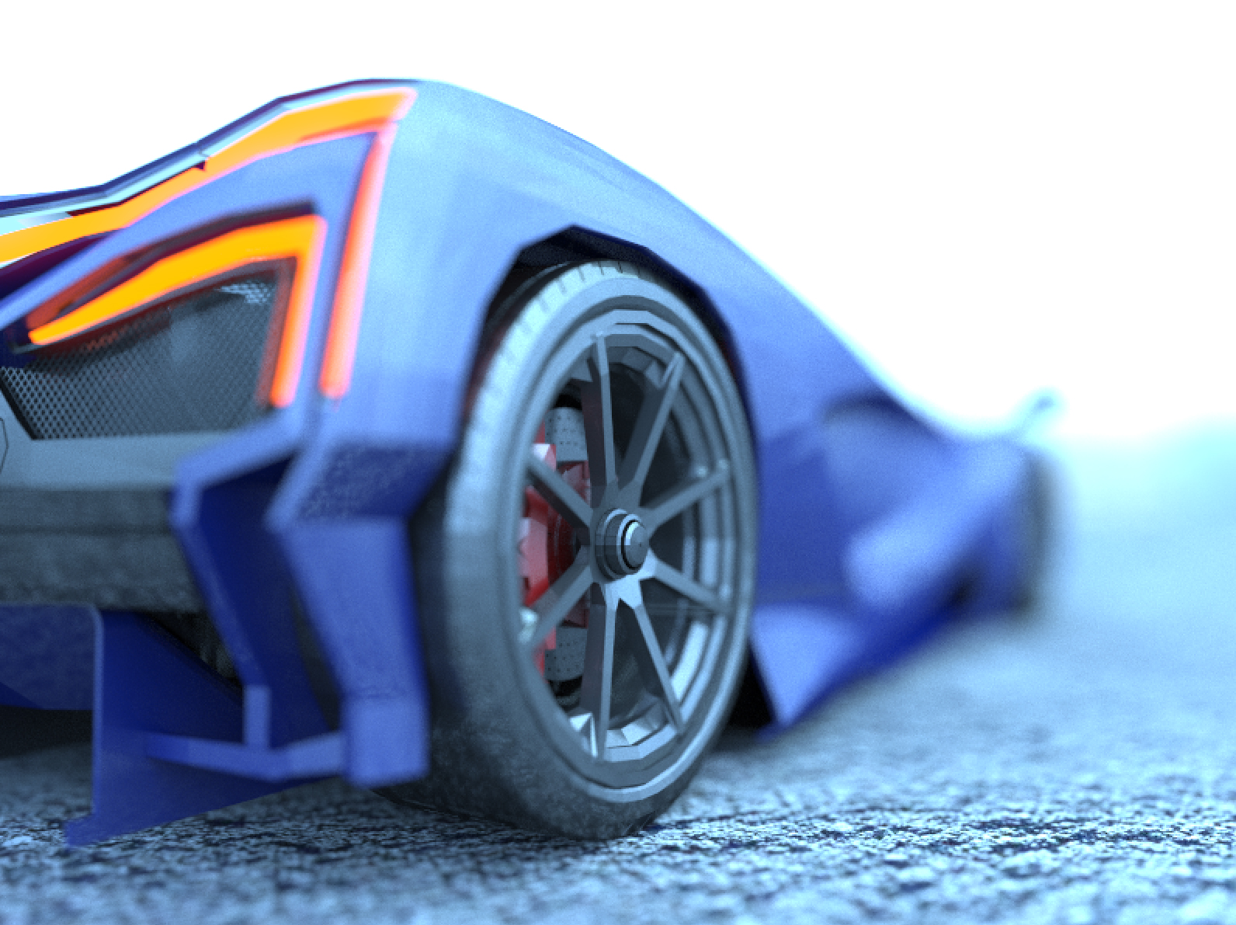
CONCLUSION
Thanks for listening (or reading)!
Don’t forget to check out the source for Final Stage 2.0, which demonstrates the concepts discussed in this talk.

