Slide 1
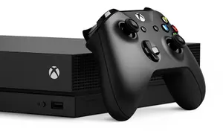
Dynamic Coverage Anti-aliasing
Real-time graphics research
Bertolami 2010
Notes:
(Content updated in 2014)

Slide 2
While conducting graphics research in early 2006 we tested a new method for anti-aliasing that provided a visual quality improvement comparable to 4x MSAA, but with about half the storage cost. In this presentation we’ll walk through the basics of the approach, and discuss our handling of several challenging edge cases.

Slide 3
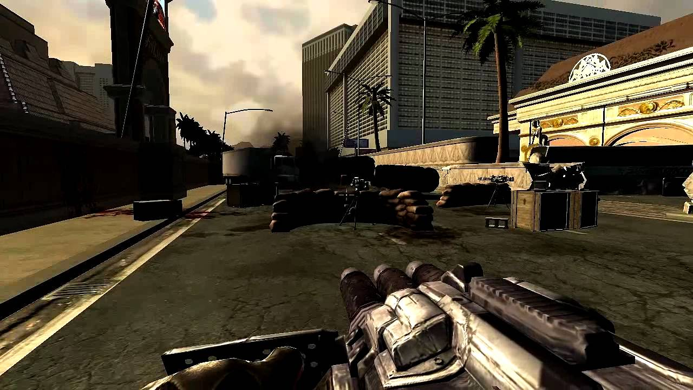
The Problem
Duke Nukem Forever
1152x640 (No AA)

Slide 4
The Problem
Duke Nukem Forever
1152x640 (No AA)

Slide 5
THE PROBLEM
The Problem
Jagged lines along object boundaries in raster based graphics systems (aka spatial discontinuities in high frequency visual data)
A
VS
Lots of ways to solve this. The simplest approach is simply increasing resolution (if possible). More advanced methods seek to smooth jagged edges where needed, while minimizing overall processing and storage costs.

Slide 6
THE PROBLEM
Popular Methods
Super-sample anti-aliasing:
Render the scene at a higher resolution and then downsample using an intelligent filter. Significantly improves visual quality but carries a high cost (typically 4x-16x the video memory, and 4x-16x additional shader processing)
Multi-sample anti-aliasing:
Render the scene at a normal resolution, but maintain multiple sub-pixel samples that can be blended together to produce a smoother final result. Significantly improves visual quality but also carries a high cost (typically 2x-16x the video memory)

Slide 7
THE PROBLEM
Walkthrough
Let’s walk through a simple example of anti-aliasing.
Two overlapping triangles intersecting our pixel. Purple triangle is in front, green triangle is behind.
Let’s assume that one color fragment is 16 bytes, and one depth fragment is 2 bytes.
our example pixel

Slide 8
THE PROBLEM
Walkthrough
Theoretically correct result
If we precisely compute the contribution of each color by area of coverage
our example pixel
rgb(221, 223, 228)

Slide 9
THE PROBLEM
No Anti-aliasing
Without anti-aliasing, the final pixel value is determined by the nearest object that overlaps the pixel center. This will result in jaggies at sub-retina DPIs, but the storage and processing costs are minimal.
Storage cost: 18 bytes (1 color, 1 depth)
Shader cost: 1x pixel shader pass

Slide 10
THE PROBLEM
Supersampling
4x supersampling effectively increases the resolution of the image by 4x. The final pixel value is determined by filtering 4 neighboring pixels down to a single value. The results are significant, but the storage and processing costs are great.
Storage cost: 72 bytes (4 color, 4 depth)
Shader cost: 4x pixel shader pass

Slide 11
4x Multisample Anti-aliasing
With 4x multisample anti-aliasing, we record color and depth values at four carefully selected sample locations within the pixel. Depth is required for sample-level depth testing against incoming fragments.
Our shader is run only once, and then samples are updated based on coverage.
Storage cost: 72 bytes (4 color, 4 depth)
Shader cost: 1x pixel shader pass

Slide 12
4x Multisample Anti-aliasing
Update phase:
for each triangle that overlaps our pixel:
for each sub-sample within the pixel:
if sub-sample is covered by the triangle:
if triangle depth is < sub-sample depth:
update sub-sample color to triangle color
update sub-sample depth to triangle depth
Resolve phase:
final pixel color = 0
for each sub-sample within the pixel:
final pixel color += (sub-sample color) / sub-sample count

Slide 13
Dynamic Coverage Anti-aliasing
With dynamic coverage anti-aliasing, we maintain two color and two depth values that indicate the two fragments that most contribute to the final pixel value.
We also record two 16 bit coverage masks that indicate the percent of coverage for each sample.
Similar to multisample antialiasing, our shader is run only once, and then samples are updated based on coverage.
Storage cost: 40 bytes (2 color, 2 depth, 2 masks)
Shader cost: 1x pixel shader pass
Note that in practice sample locations are carefully (not evenly) distributed

Slide 14
Dynamic Coverage Anti-aliasing
Update phase:
for each triangle that overlaps our pixel:
IM = 0
for each coverage sample within the pixel:
if coverage sample is covered by the triangle:
set IM[coverage sample index] = 1
if ID is < SD0 or ID is < SD1:
if SD0 < SD1:
SC1 = IC, SD1 = ID, SM1 = IM
else:
SC0 = IC, SD0 = ID, M0 = IM
For each pixel we maintain the following storage. At the start of the frame all masks are initialized to 0xFFFF, colors to clear color, depth to DEPTH_MAX.
SC0 = sample 0 color, SC1 = sample 1 color
SD0 = sample 0 depth, SD1 = sample 1 depth
SM0 = sample 0 mask, SM1 = sample 1 mask
When writing shaded fragments to our buffers we also define:
IC = incoming color, ID = incoming depth, IM = incoming mask
Resolve phase:
if SD0 < SD1:
output color =
(SC0 * SMC0 + SC1 * (SM1 & ~SM0)) / TCC
else:
output color =
(SC1 * SMC1 + SC0 * (SM0 & ~SM1)) / TCC
At the end of our frame we resolve our samples with:
TCC = number of unique bits set across SM0 and SM1
SMC0 = count of bits set in SM0
SMC1 = count of bits set in SM1

Slide 15
Dynamic Coverage Anti-aliasing
Update phase:
for each triangle that overlaps our pixel:
IM = 0
for each coverage sample within the pixel:
if coverage sample is covered by the triangle:
set IM[coverage sample index] = 1
if ID is < SD0 or ID is < SD1:
if SD0 < SD1:
SC1 = IC, SD1 = ID, SM1 = IM
else:
SC0 = IC, SD0 = ID, M0 = IM
For each pixel we maintain the following storage. At the start of the frame all masks are initialized to 0xFFFF, colors to clear color, depth to DEPTH_MAX.
SC0 = sample 0 color, SC1 = sample 1 color
SD0 = sample 0 depth, SD1 = sample 1 depth
SM0 = sample 0 mask, SM1 = sample 1 mask
When writing shaded fragments to our buffers we also define:
IC = incoming color, ID = incoming depth, IM = incoming mask
If our incoming depth is closer than at least one of our cached samples, then we evict the farthest one and replace it with the incoming values (color, depth, mask)
Resolve phase:
if SD0 < SD1:
output color =
(SC0 * SMC0 + SC1 * (SM1 & ~SM0)) / TCC
else:
output color =
(SC1 * SMC1 + SC0 * (SM0 & ~SM1)) / TCC
At the end of our frame we resolve our samples with:
TCC = number of unique bits set across SM0 and SM1
SMC0 = count of bits set in SM0
SMC1 = count of bits set in SM1

Slide 16
Dynamic Coverage Anti-aliasing
Update phase:
for each triangle that overlaps our pixel:
IM = 0
for each coverage sample within the pixel:
if coverage sample is covered by the triangle:
set IM[coverage sample index] = 1
if ID is < SD0 or ID is < SD1:
if SD0 < SD1:
SC1 = IC, SD1 = ID, SM1 = IM
else:
SC0 = IC, SD0 = ID, M0 = IM
For each pixel we maintain the following storage. At the start of the frame all masks are initialized to 0xFFFF, colors to clear color, depth to DEPTH_MAX.
SC0 = sample 0 color, SC1 = sample 1 color
SD0 = sample 0 depth, SD1 = sample 1 depth
SM0 = sample 0 mask, SM1 = sample 1 mask
When writing shaded fragments to our buffers we also define:
IC = incoming color, ID = incoming depth, IM = incoming mask
Resolve phase:
if SD0 < SD1:
output color =
(SC0 * SMC0 + SC1 * (SM1 & ~SM0)) / TCC
else:
output color =
(SC1 * SMC1 + SC0 * (SM0 & ~SM1)) / TCC
At the end of our frame we resolve our samples with:
TCC = number of unique bits set across SM0 and SM1
SMC0 = count of bits set in SM0
SMC1 = count of bits set in SM1
Output equals the weighted average of our cached samples, with weights computed by sample coverage of the pixel

Slide 17
Whiteboarding time
(let’s explore edge cases)

Slide 18
DISCUSS & DEBRIEF
What cases did you discuss?
Partial triangle overlap of a pixel without any coverage?
Thin triangle overlap with no majority coverage?
Many triangle overlaps with equal coverage?

Slide 19
THE PROBLEM
Summary
Method | Storage costs | Pixel shader costs | Output color
No AA | 18 bytes (1x color, 1x depth) | 1x pixel shader passes
4x Supersample | 72 bytes (4x color, 4x depth) | 4x pixel shader passes
4x Multisample | 72 bytes (4x color, 4x depth) | 1x pixel shader passes
2x Dynamic coverage | 40 bytes (2x color, 2x depth, 2x masks) | 1x pixel shader passes
rgb(217, 210, 233)
rgb(217, 216, 228)
rgb(227, 227, 233)
rgb(217, 219, 225)
Theoretically correct value:
rgb(221, 223, 228)

